Slide 1
Specialised Commissioning
Sarah Watson, Programme Director Highly Specialised Services – Internal Medicine
Yorkshire Thoracic Society
21st March 2014

Slide 2
Introduction
Specialised services account for approximately 10% of the total NHS budget, spending circa £12.2 billion per annum
The commissioning of specialised services is a prescribed direct commissioning responsibility of NHS England
Specialised services are those provided in relatively few hospitals, accessed by comparatively small numbers of patients but with catchment populations of usually more than one million

Slide 3
The 4 Factors
Four factors determine whether NHS England commissions a service as a prescribed specialised service.
These are:
The number of individuals who require the service;
The cost of providing the service or facility;
The number of people able to provide the service or facility and
The financial implications for Clinical Commissioning Groups (CCGs) if they were required to arrange for provision of the service or facility themselves

Slide 4
The Ambition
The ambition of NHS England is to bring equity and excellence to the provision of specialised care and treatment. This is achieved through a commissioning process which:
is patient-centred and outcome based. The patient must be placed at the centre of planning and delivery. Commissioners, working with providers, must deliver improved outcomes for them across each of the five domains of the 2013/14 NHS Outcomes Framework;
is fair, consistent throughout the country, ensuring that patients have equal access to services regardless of their location, and;
Improves productivity and efficiency.

Slide 5
Who commissions?
NHS England delivers its specialised commissioning responsibilities through its central support team; four regional offices and through 10 of its 27 area teams. The area teams with responsibility for specialised commissioning are:
Cumbria, Northumberland, Tyne and Wear
South Yorkshire and Bassetlaw
Cheshire, Warrington and Wirral
East Anglia
Leicestershire and Lincolnshire
Birmingham and the Black Country
Wessex
Bristol, North Somerset and South Gloucestershire
Surrey and Sussex
London

Slide 6

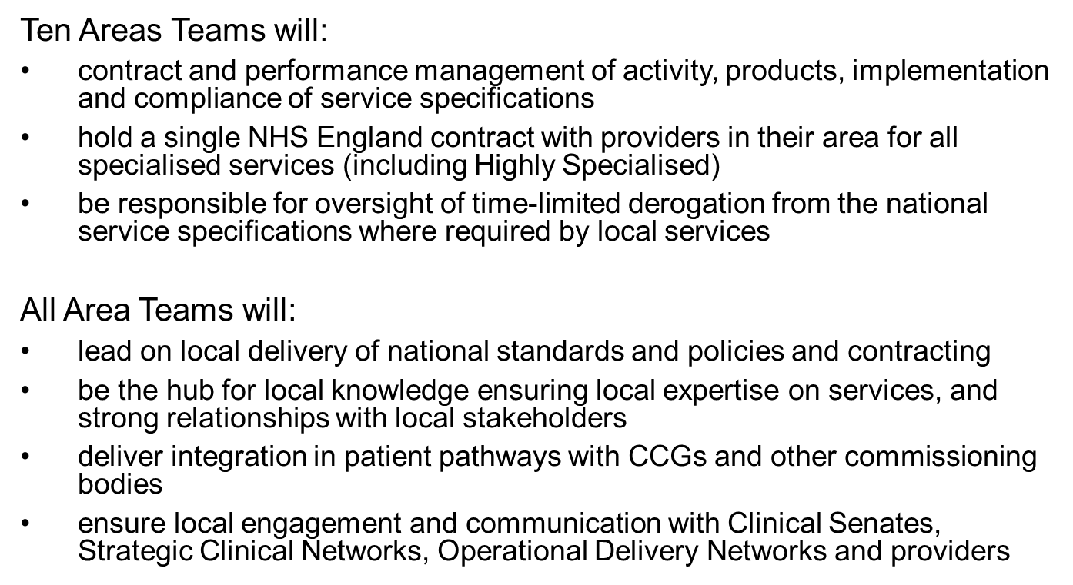

Slide 8
Specialised Commissioning in the North of England
Cheshire Warrington and Wirral
Cumbria, Northumberland, Tyne and Wear, South Yorkshire and Bassetlaw
Cheshire Warrington and Wirral
  area teams are responsible for specialised commissioning

Slide 9
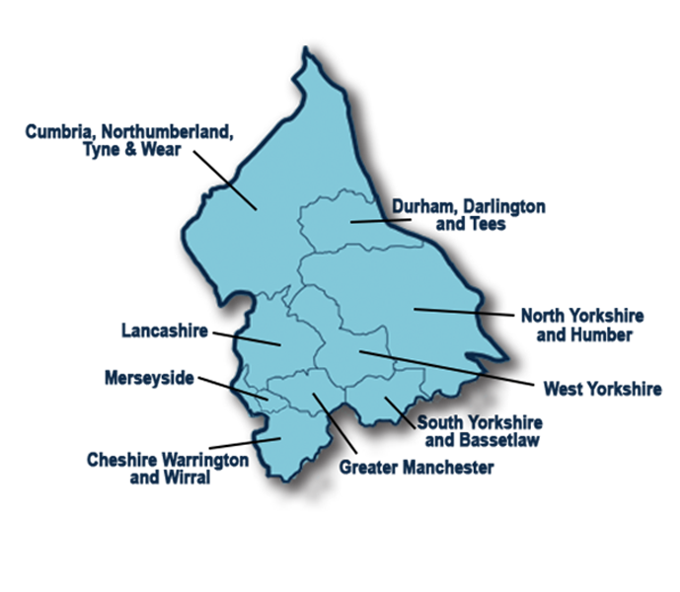
The North of England

Slide 10
National Programmes of Care
5 Programmes of Care
Internal Medicine - digestion, renal, hepatobiliary and circulatory system
Cancer and Blood - infection, cancer, immunity and haematology
Mental Health
Trauma - traumatic injury, orthopaedics, head and neck and rehabilitation
Women and Children - women and children, congenital and inherited diseases

Slide 11
Clinical Reference Groups in Internal Medicine PoC
A01. Cystic Fibrosis
A02. Hepatobiliary and Pancreas
A03. Specialised Endocrinology
A04. Vascular Disease
A05. Severe and Complex Obesity
A06. Renal Dialysis
A07. Renal Transplant
A08. Specialised Colorectal Services
A09. Complex Invasive Cardiology
A10. Cardiac Surgery
A11. Pulmonary Hypertension
A12. Specialised Dermatology
A13. Specialised Rheumatology
A14. Specialised Respiratory
A15. Interventional Radiology
A16. Specialised Imaging
A17. Specialised Diabetes
A18. Heart & Lung Transplantation

Slide 13
Specialised Respiratory CRG
The services encompassed by this Clinical Reference Group (CRG) include:
the management of patients with complex respiratory disease who need assisted ventilation at home;
services for people with severe and difficult to control asthma;
services for people with interstitial lung disease.

Slide 14
Specifications:
Ataxia telangiectasia service (Adult)
Respiratory Complex Home Ventilation (Adult)
Respiratory Severe Asthma (Adult)
Respiratory Interstitial Lung Disease(Adult)
Chronic Pulmonary Aspergillosis Service (Adults)

Slide 15
Compliance Exercise
Nearly 200 specifications for specialised services
Whilst these specifications were used to inform the 2013/14 contracting round, they only became a requirement of providers as of 1 October 2013
NHS England established a process in order to assess levels of provider compliance against key requirements set out in the service specifications
The compliance exercise forms part of an iterative process of improvement

Slide 16
Specialised Respiratory Specifications
Paused for 13/14
Difficulties with capturing activity
In contract by April 2014
Delayed start with Provider/ AT discussions
Parts of the country have made more progress than others agreeing contracts (no different from some of the other specialities)

Slide 17
Key Requirements
A14/S/a Respiratory: Complex Home Ventilation (Adult)
In patient weaning beds and on site ITU
At least two consultants with expertise in respiratory physiology, weaning and complex ventilation
24/7 specialist consultant on call cover and resident specialist respiratory or critical care registrar with direct responsibility for the Unit
Specialist respiratory and rehabilitation physiotherapist

Slide 18
Progress
Specialised Commissioners working with trusts that indicated compliance with the service specification and seeking assurance of their full compliance with all elements of the national service specification

Slide 19
Policies being drafted
Bronchial thermoplasty for chronic asthma
Inflixumab for refractory sarcoidosis
Rituxumab for CTD-ILD
Chronic pulmonary aspergillosis (Adult)
Others?

Slide 20
Website
http://www.england.nhs.uk/ourwork/commissioning/spec-services/

